Slide 1

Spam Message Detector

Slide 2

Problem Statement:
• With the increasing use of digital communication channels like SMS, emails, and messaging apps, users are constantly targeted by unwanted spam messages.
• Spam messages not only clutter communication platforms but also pose risks such as phishing, fraud, and malware attacks.
• The problem we address in this project is the need for an automated and accurate system that can differentiate between spam and non-spam (ham) messages.

Slide 3

• Our goal is to build a machine learning-based Spam Message Detector that can efficiently classify messages in real-time, helping users avoid potential threats and maintain clean communication channels.
• By leveraging natural language processing techniques and classification algorithms, we aim to create a system that is reliable, scalable, and easy to integrate into existing platforms.

Slide 4
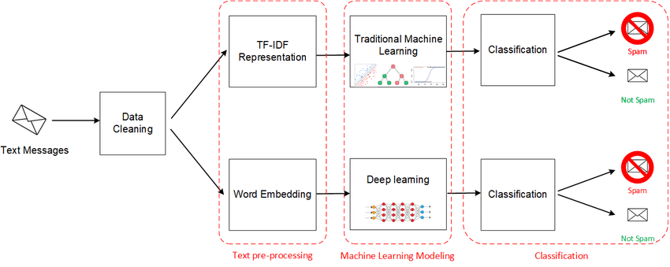
Architecture Diagram:
• Input: Text messages are collected as the raw input data.
• Data Cleaning: Messages are cleaned by removing unwanted characters, stopwords, and performing basic text normalization (like lowercasing, punctuation removal).

Slide 5
• Text Pre-processing:
Option 1: TF-IDF Representation: Converts text into numerical features based on term frequency and inverse document frequency.
Option 2: Word Embedding: Converts text into dense vector representations capturing semantic meaning.
• Machine Learning Modeling:
Path 1: Traditional Machine Learning: Machine learning models like SVM, Random Forest, or Naive Bayes are trained using TF-IDF features.
Path 2: Deep Learning: Deep learning models like Neural Networks are trained using word embeddings.
• Classification: Both approaches independently classify the messages as Spam or Not Spam.
• Output: Final output shows whether the given text message is detected as Spam or Not Spam.

Slide 6
Implementation Details:
Data Used
• Dataset: SMS Spam Collection Dataset.
• Total Messages: 5,574 SMS texts.
• Labels:
'Ham' — Normal messages.
'Spam' — Unwanted messages.
• Sources:
Grumbletext website (spam messages).
NUS SMS Corpus (ham messages from Singapore students).
Caroline Tagg’s PhD Thesis (ham messages).
SMS Spam Corpus v.0.1 Big (ham and spam messages).
• Use Case: Text classification and spam detection research.

Slide 7
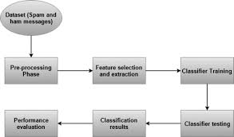
Data Preprocessing:
Uploaded the dataset using Google Colab.
Cleaned the text by converting to lowercase and removing non-alphabet characters.
Removed common stopwords using NLTK library.
• Feature Extraction:
Used TF-IDF (Term Frequency-Inverse Document Frequency) Vectorizer to convert text into numerical vectors.
• Label Encoding:
Converted the 'ham' and 'spam' labels into 0 and 1 respectively.
• Model Training:
Split the dataset into 80% training and 20% testing sets.
Trained a Multinomial Naive Bayes classifier on the TF-IDF vectors.

Slide 8
• Model Evaluation:
Achieved high accuracy as shown in the classification report.
Generated a Confusion Matrix to visualize true positives, true negatives, false positives, and false negatives.
• Model Saving:
Saved the trained Naive Bayes model and TF-IDF vectorizer using Joblib.
Provided download links to save the model locally.

Slide 9
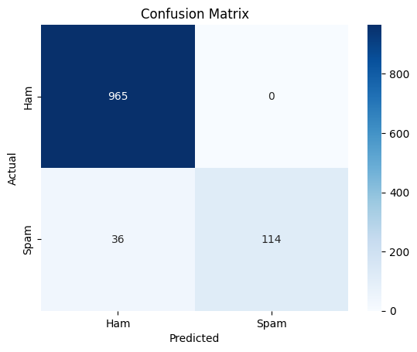
Output:
After training the model and making predictions on the test data, we generated the confusion matrix shown below.
->It clearly shows how well our model performed — it was able to correctly classify most of the ham and spam messages.
->We can see that 965 ham messages were predicted correctly, and 114 spam messages were also correctly identified.
->Only 36 spam messages got misclassified as ham.
->This gives a quick visual idea of where the model is doing well and where there are small mistakes.

Slide 10
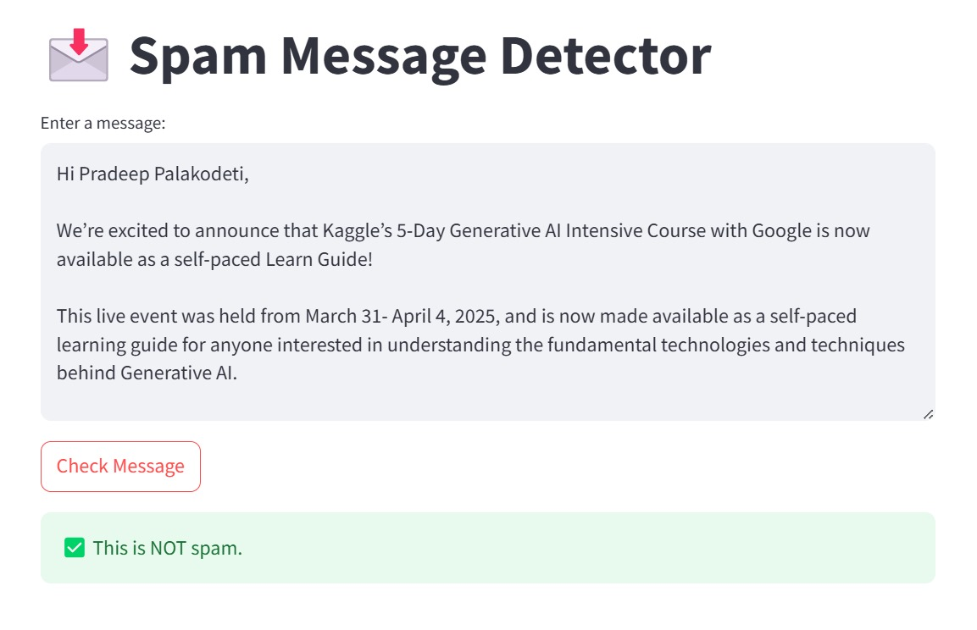
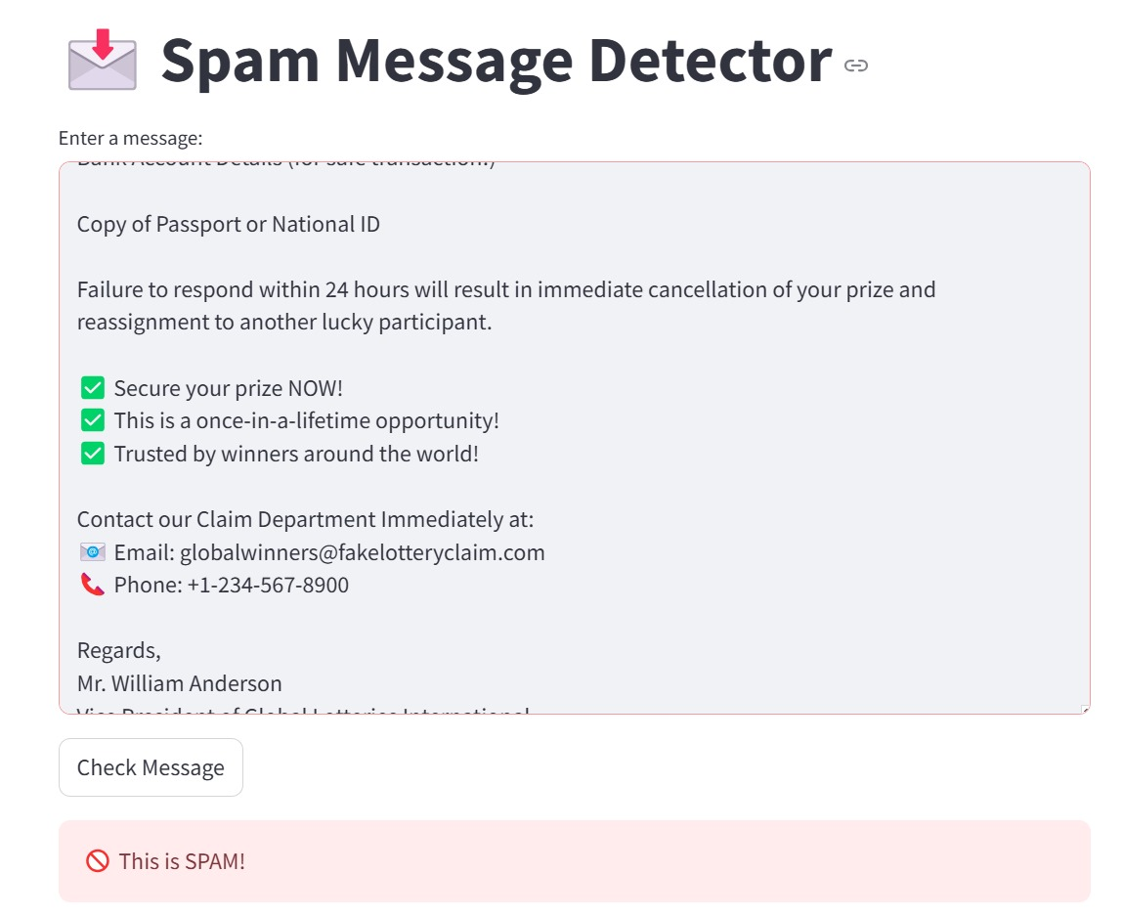

Slide 11
Demo Link:
Google Collab:The project notebook can accessed through the provided Google Collab link.
Data Set: The project dataset can be accessed through the provided and Kaggle link.
Team members: 1) P VENGAMA NAIDU-RA2311003011125
2) K DUSHYANTH-RA2311003011123
3)P RISHIT-RA2311003011130

